Slide 1
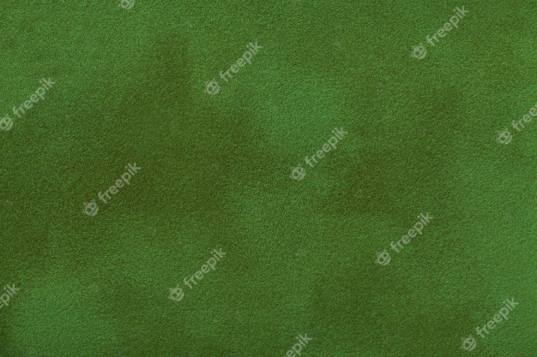
The Second Aeon: Rāmāyaṇa
Roadmap 2021

Slide 2
Tentative Target Dates:
Palace Environment and Terrain: 29th August 2021
Player Character: 26th September 2021
NPC Mesh and Anim 1 [Sītā, Lakṣmaṇa, et cetera]: 17th October 2021
NPC Mesh and Anim 2 [Enemies]: 30th October 2021
Foliage Assets Modelling and Texturing: 30th October 2021
Foliage Assets Placement and Optimization: 7th November 2021
Level-wise Mechanics 1 [Palace and Wilderness]: 14th November 2021
Level-wise Mechanics 2 [Laṅkā]: 21st November 2021
NPC AI 1 [Sītā, Lakṣmaṇa, et cetera]: 12th^{th} December 2021
NPC AI 2 [Enemies]: 26th December 2021

Slide 3
Development target dates till September
Landscapes: 22nd August 2021
Terrain interactivity: 29th August 2021
Palace environment: 29th August 2021
Player Character Mesh: 6th September 2021
Player Character Animation:
Movement: 13th September 2021
Weapon Draw/Sheathe: 20th September

